Slide 1
E-Commerce Product Delivery Prediction

Slide 2
AGENDA
Introduction
Dataset Overview
Exploratory Data Analysis
Data Preprocessing
Model Selection and Evaluation
Conclusion

Slide 3

INTRODUCTION
E-Commerce involves buying and selling goods and services over an electronic system such as internet and other computer networks.
“In the ever growing realm of E-Commerce ,this project focuses on the strategic refinement of prediction algorithms utilizing machine learning techniques” .
However in the world of E-Commerce , On-Time product delivery is very important and essential for customer satisfaction .
This project prioritizes On-Time delivery rate as main business metrics.

Slide 4
DATASET OVERVIEW
This dataset is about international e-commerce company specializing in electronic products.
Dataset Summary
Key Attributes
Warehouse Block : Source of shipment (A,B,C,D,E)
Mode Of Shipment : Ship ,Flight ,Roads
Product Importance : Low ,High ,Medium
Total Records : 10,999 rows
Features:12 features including : ID,Warehouse Block ,Mode of shipment , Customer care calls ,Cost of product(In Dollars) ,Weights in grams ,Customer Rating ,Prior purchases ,Product Importance ,Gender ,Discount Offered.
Target Variable : Reached On Time_Y_N
1:Not On Time
0:On Time
No missing values and no outliers in the given dataset.

Slide 5





OBJECTIVES
Predicting whether the products will reach customer on time using machine learning models.
Understanding the product delivery patterns and customer behavior.
Understanding the key factors influencing the product delivery times
Improving Customer Satisfaction by predicting delivery timeliness.
Optimizing Logistics and gaining operational insights.

Slide 6
END TO END DEPLOYMENT FLOW
Dataset
Data collection, and Cleaning
Data Modelling Selection and Training
Evaluation of Model and Optimization.
Exploratory Data Analysis,Feature Engineering,Data Encoding and Scaling
Model Deployment.
User

Slide 7
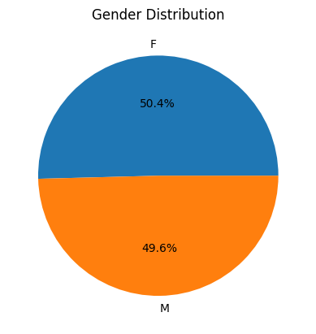
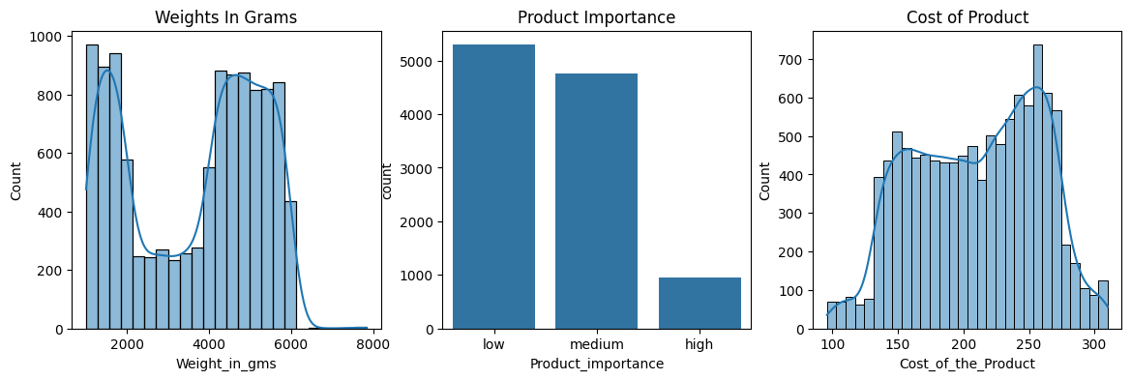
EXPLORATORY DATA ANALYSIS
UNIVARIATE DATA ANALYSIS
Product Properties
Almost Equal number of male and female customers.Female 50.4% and Male 49.6%
Products primarily weight between “1000-2000 g” and “4000-6000” g.
Product Importance depicts most shipments are “LOW” followed by “MEDIUM” and the least are “HIGH”.
Frequency of Products prices between “$150-200 “and “$235-275”.

Slide 8
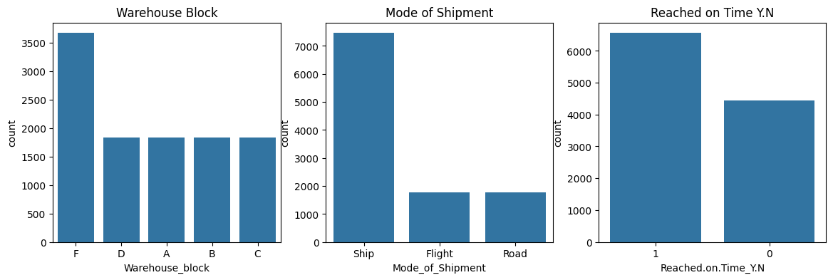
Logistics and Delivery Aspects
Most Shipments come from Warehouse Block “F” It handles greater than “3500 products”.
Based on Mode of Shipment majority of orders are delivered via “SHIP”.
There are fewer ON_TIME deliveries than late deliveries.

Slide 9
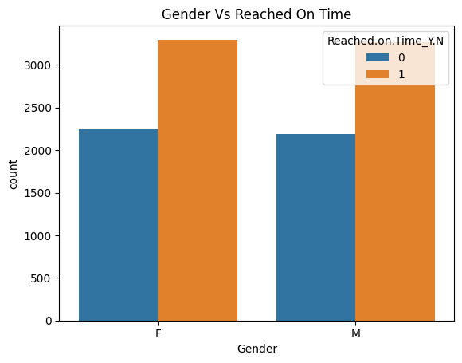
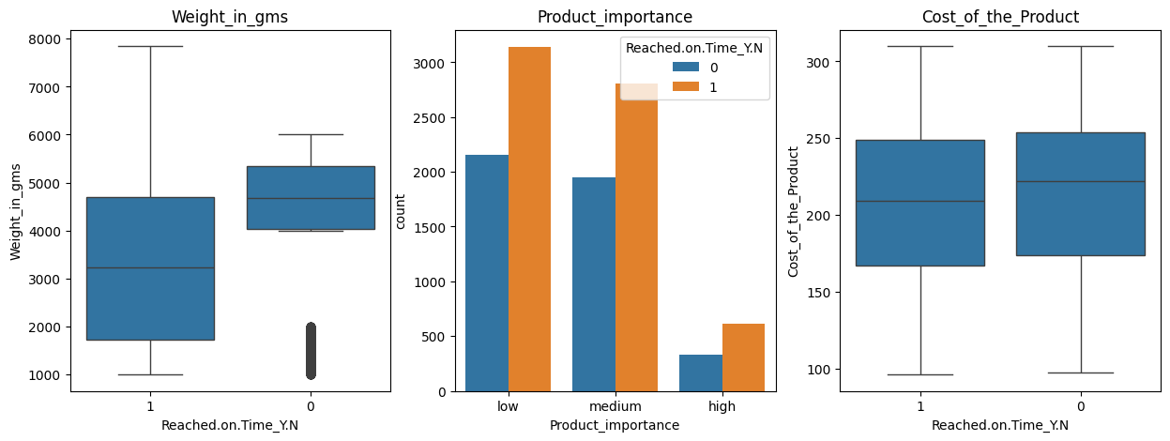
BIVARIATE ANALYSIS
Product Properties VS Reached On Time
Timely delivery of products across both genders.
Late Deliveries around 1000-4000 g and > 6000g.
High importance products face late deliveries than other product importances.

Slide 10
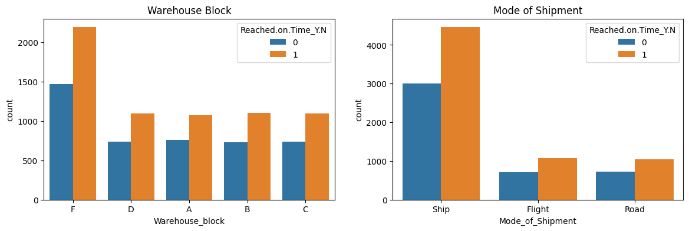
Logistics VS Reached On Time
As there is a consistent difference in the number of products delivered on time versus late across all warehouses and shipping methods,this consistency suggest that logistics do not significantly affect timeliness of product delivery.

Slide 11
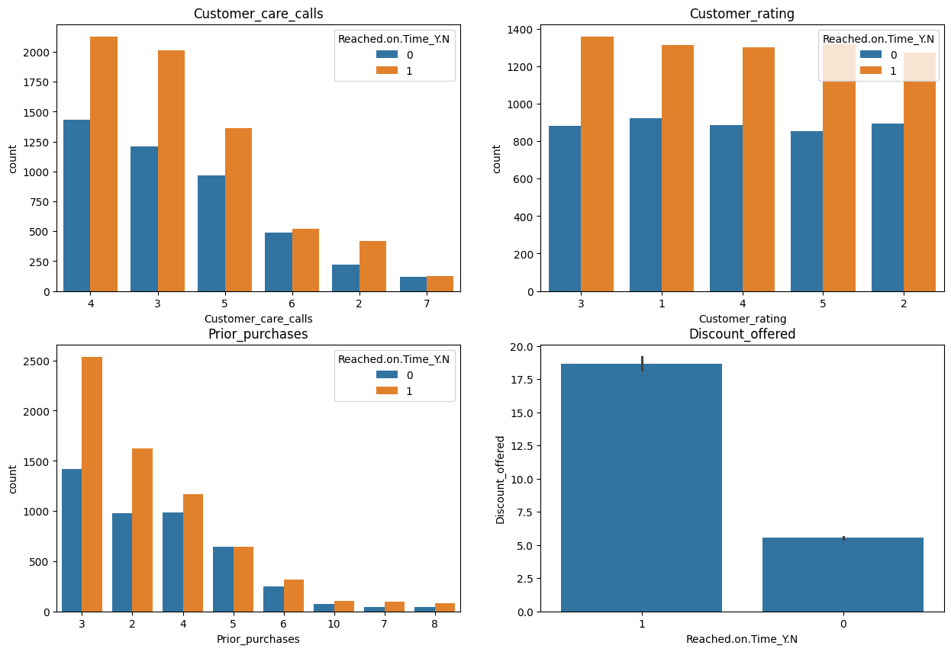
Customer Experience VS Reached On Time
As customer care call increases,ON Time delivery decreases.
All deliveries mostly are late across all customer ratings . Considering,this factor doesn’t influence the status of the delivery.
Repeated customers have better delivery outcomes.
Products with less than 7% discount often reached on time.

Slide 12
KEY FINDINGS
The project's objective was to forecast on-time delivery for an e-commerce company's products and to explore factors influencing delivery times and customer behaviour. The exploratory analysis highlighted that :
Higher discounts are more likely to be associated with late deliveries. This means that the more discount an order has, the higher the probability that it will be late.
2. Lower product weights are more likely to be associated with late deliveries. This means that the lighter the weight of a product, the higher the probability that it will be late.
3. Interestingly, people with more prior purchases are slightly less likely to experience late deliveries
4. Higher product importance tend to be associated with late deliveries
5. Customer behaviour also sheds light on delivery outcomes. An increase in customer care calls often correlates with delivery delays.

Slide 13
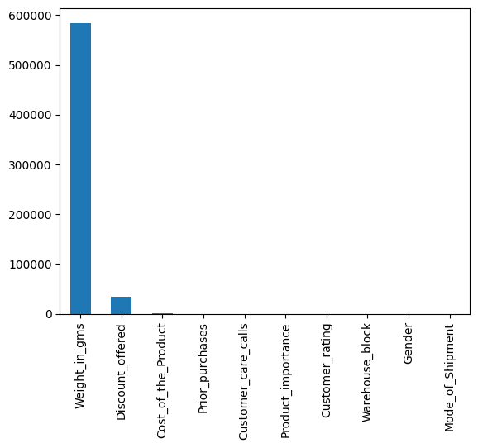
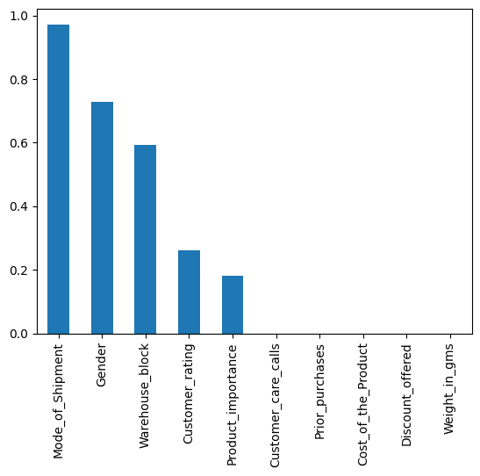
DATA PREPROCESSING
Feature Selection
The Chi-Square test can be used to determine if there is a significant association between each feature and the target variable.
Higher the chi scores more important the feature.
Greater the p score (>0.05) less important the feature
Features Selected : Discount offered , Weights in grams , Product Importance , Prior Purchases , Cost of product
Chi Scores Chart
P-Value Chart

Slide 14
Feature Encoding
Converted categorical features like Warehouse block , Mode of shipment , Product Importance and Gender into numeric using LabelEncoder.
Feature Scaling
Applied StandardScaler for the betterment of the performance of the machine learning models.
Train Test Split
Divided the data into training(80%) and testing(20%) sets.
X:Typically represents independent variables.
Y:Represents dependent (target) variable that we want to predict or understand.

Slide 15
MODEL SELECTION
Model Used
RandomForest : It is a robust supervised algorithm suitable for both regression and classification.
DecisionTree : It is used for both classification and regression as they are simple , computationally efficient and
effective in handling high dimensional data.
LogisticRegression : It is commonly used for binary classification problems . It’s preferred because it provides a simple an efficient way to model the relationship between independent variables and the probability of a certain outcome.
SVM
KNN

Slide 16
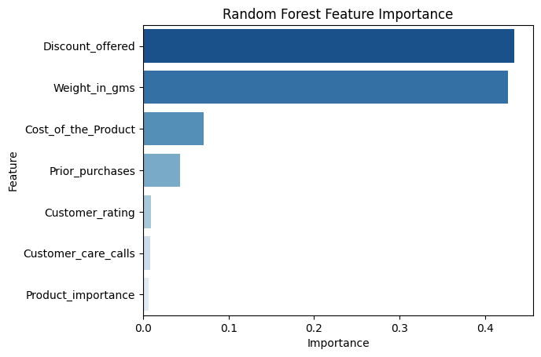
MODEL PERFORMANCE
Model | Accuracy% | Precision% | Recall% | F1-Score%
RandomForest | 68(Increased after Hyperparameter tunning) | 99 | 55 | 69
DecisionTree | 67 | 93 | 54 | 69
LogisticRegression | 64 | 58 | 53 | 55
KNN | 65 | 60 | 54 | 57
SVM | 67 | 75 | 55 | 63
The dataset has very less on_time delivery rate.
Regarding machine learning models, the RandomForest classifier outperformed others with a 68% accuracy rate. Close behind were the DecisionTree classifier , and SVM with 67% , followed by KNN and LogisticRegression.
FEATURE IMPORTANCE
Discount is the most important factor associated with delivery status, followed by weight.

Slide 17
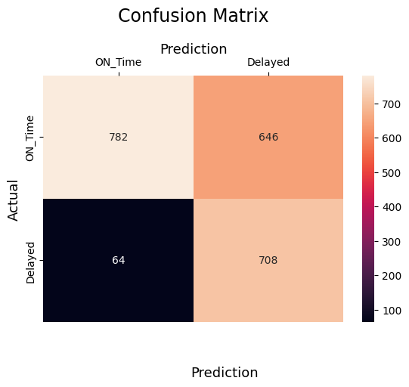
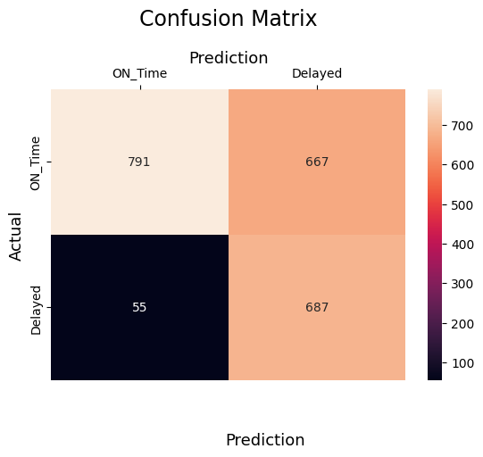
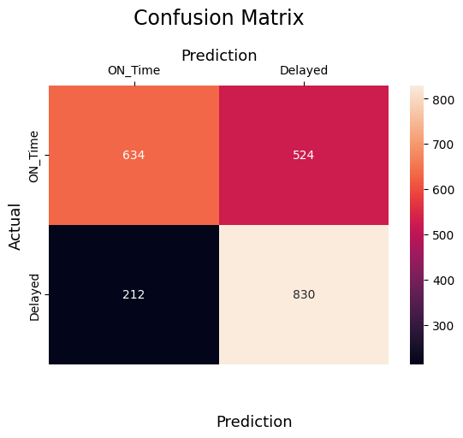
Confusion Matrix
TP : Model correctly predicts on time deliveries.
TN : Model correctly predicts late deliveries.
FP : On Time deliveries that are predicted late.
FN : Late deliveries that are predicted on time.
RandomForest
DecisionTree
SVM
The confusion matrix shows that random forest predicts late deliveries more accurately, but at the cost of increased false positives (on-time deliveries that are predicted late) but not as much as Decision Tree. This is not a major problem, because the delivery will still be on time regardless of the late prediction. The core problem is late deliveries that are predicted on time, which can make customers unhappy and less trusting of our company. Random forest does a decent job of avoiding this problem than SVM although Decision Tree does this better but it produces too many False Positives.

Slide 18
BUSINESS RECOMMENDATIONS/CONCLUSION:
Implement Discount Threshold policy
Bundled products shipment
Inform customer about the delay and extend the estimated delivery date.
Offer incentives to customers who experience late deliveries.

